Slide 1
RFID and Keypad Based Security System using 8051
Security system designed using 8051 micro controller and em-18 RFID module
Submitted By:
Aravinth S (2018105010)
Gokilavani B (2018105016)
Lakshmini N S (2018105026)
Vishal K Setti (2018105074)

Slide 2
Table of Contents
Project Objective
Block Diagram
Hardware Components
Component Descriptions
Software Requirements
Working Model
Conclusion

Slide 3
Project Objective
Provide security to organizations like schools, universities,
office and stations.
Access allowed only to authorized personnel with a valid
RFID tag.

Slide 4
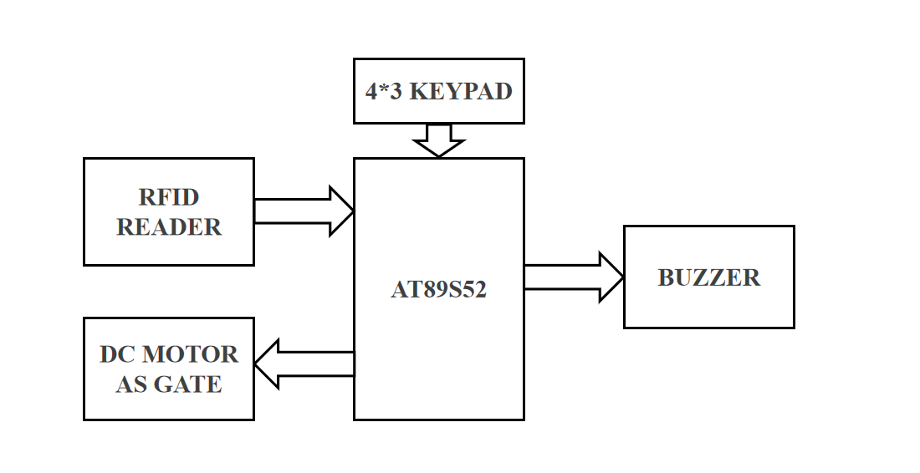
Block Diagram

Slide 5
Hardware Components
Component | Specification
Microcontroller | 8051 Series (AT89S52)
RFID Reader | EM-18 Reader module
RFID Tags | Passive Card Type
Programming Board | 8051 Series (AT89S52)
Power Supply | 12 volts
Buzzer | Active
Keypad | 4 X 3 Keypad
DC Motor | L293D,2V
LED | 1V
Others | Crystal Oscillator,Capacitors, Resistors,Switches,Connectors, Power cable

Slide 6
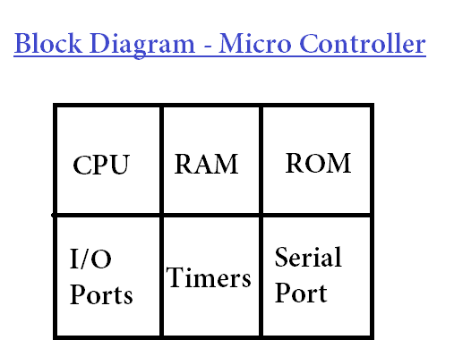
Microcontroller - 8051
AT89S52 – is the 8051 variant from Atmel.
A micro controller is an integrated circuit or a chip with a processor and other support devices like program memory, data memory, I/O ports, serial communication interface etc integrated together.

Slide 7
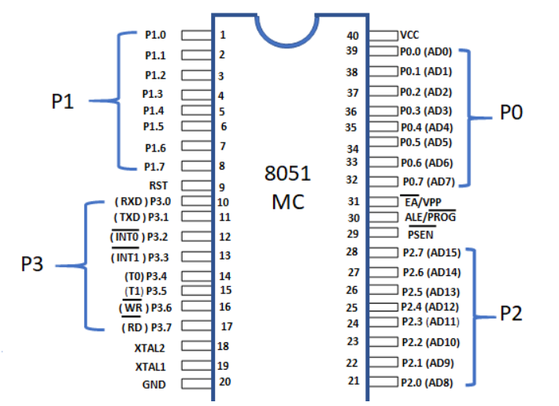
8051 – Pin Diagram

Slide 8
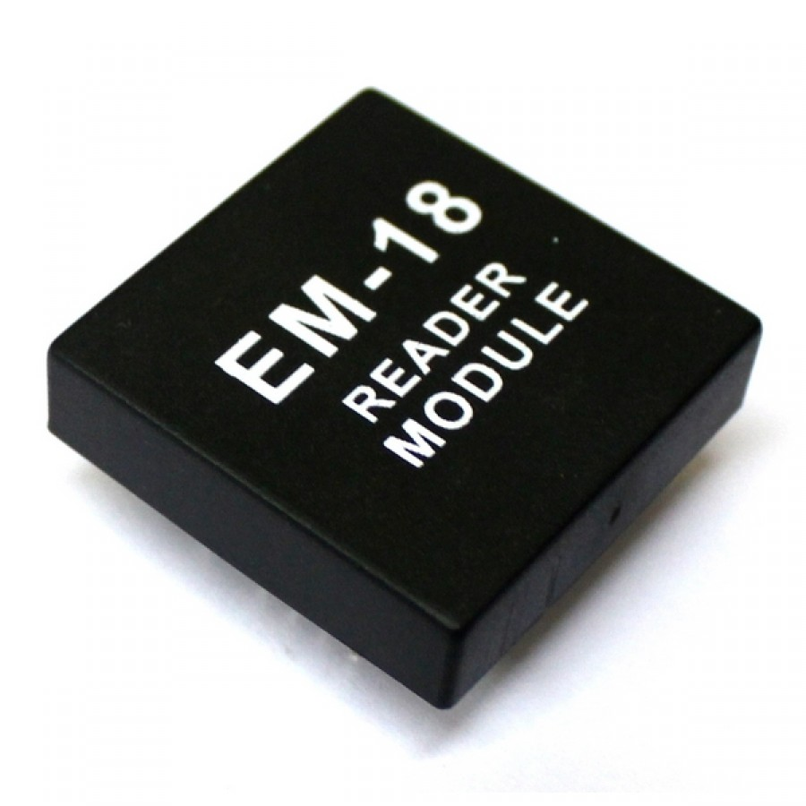
RFID Reader Module
The reader basically contains a coil and an electronic circuit.
The coil serves as exciter for the card and also the antenna for receiving the signal propagated by the card.
The electronic circuit demodulates this signal and converts it into a form suitable for the next stage (microcontroller).
This RFID is working at baud rate of 9600 bps.

Slide 9
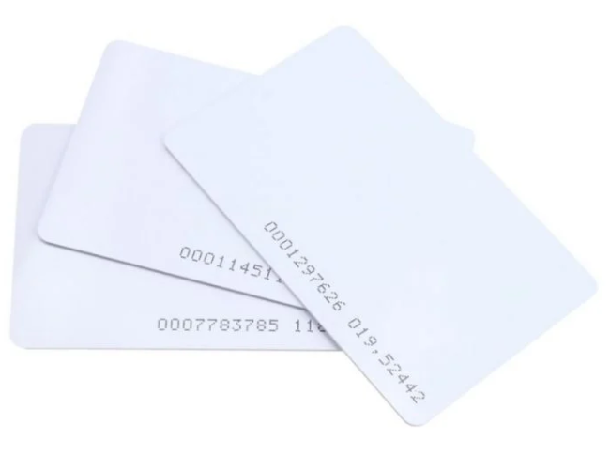
RFID Tags
It contains a semiconductor memory for storing the unique ID code, modulating circuit and a coil.
The coil acts as the power source by means of electromagnetic induction while in the vicinity of the reader.
It also serves as the antenna for propagating the ID code. The modulating circuit modulates the unique code into the transmitted wave.
The reader basically contains a coil and an electronic circuit.

Slide 10
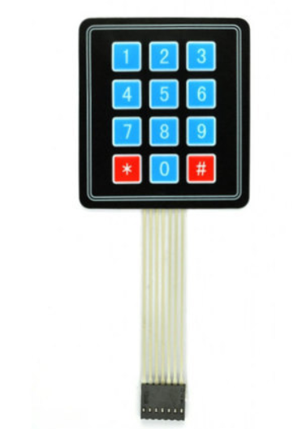
4 X 3 Keypad
Punch in your secret key into this numeric matrix keypad. This keypad has 12 buttons, arranged in a telephone-line 3x4 grid.
It's made of a thin, flexible membrane material with an adhesive backing so you can attach it to nearly anything.
The keys are connected into a matrix, so you only need 7 microcontroller pins (3-columns and 4-rows) to scan through the pad.

Slide 11
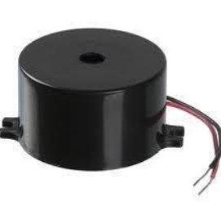
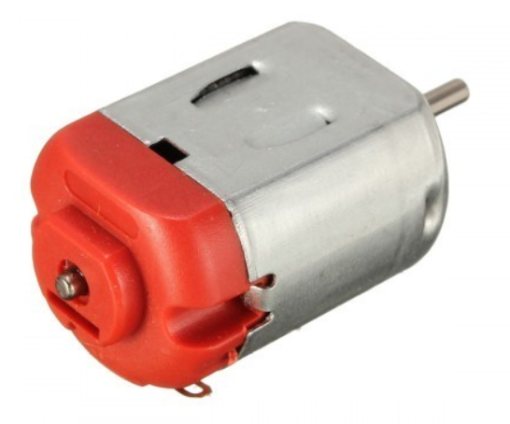
DC Motor and Buzzer
This section has a motor driver L293D for opening gate and a buzzer with a BC547 NPN transistor for indications.
A buzzer or beeper is an audio signaling device,which may be mechanical, electromechanical, or piezoelectric.
Typical uses of buzzers and beepers include alarm devices, timers, and confirmation of user input such as a mouse click or keystroke.

Slide 12
Working Model
We store a set of RFID tag data (unique RFID codes/keys) inside our program/system, say 3 or 10 RFID tag data.
The system comprises of a micro controller (8051 series), an RFID Reader module and a power supply circuitry to give power to microcontroller, RFID module.
When the person with the right RFID tag and password come and swipes his RFID tag near the RFID reader, access will be granted.
When the person with the wrong RFID card swipes his RFID tag, access will be denied.
The LED will show different status messages.

Slide 13
Software Requirements:
Software development involves 4 stages:
Stage 1 → Saving the authorized RFID keys
Stage 2 → Reading an RFID Tag for comparison
Stage 3 → Comparing the read RFID key with the saved values
Stage 4 → Output - grant or deny access based on comparison stage output and password.
Compiler: Keil

Slide 14
Conclusion
When RFID reader reads the correct unique code, the green LED light glows and motor starts to rotate.
And when RFID reader reads wrong code red LED light glows and buzzer beeps.

Slide 15
THANK YOU

